Slide 1
Topics
Demultiplexing of buses
Generation of control signals
Instruction Set

Slide 2
The address bus has 8 signal lines A8 – A15 which are unidirectional.
The other 8 address bits are multiplexed(time shared) with the 8 data bits.
AD0 –AD7 are bi-directional and serve as A0 –A7and D0 –D7 at the same time.
During the execution of the instruction, these lines carry the address bits during the early part, then during the later part of the execution, they carry the 8 data bits.
In order to separate the address from the data, we can use a latch to save the value before the function of the bits changes.

Slide 3
Demultiplexing of AD7-AD0
The high order bits of the address remain on the bus for three clock periods.
However, the low order bits remain for only one clock period and they would be lost if they are not saved externally.

Slide 4
To make sure we have the entire address for the full three clock cycles, an external latch to save the value of AD7–AD0 when it is carrying the address bits.
We use the ALE signal to enable this latch.
ALE operates as a pulse during T1 to latch the address. Then when ALE goes low, the address is saved and the AD7–AD0 lines can be used for their purpose as the bi-directional data lines D0 to D7.

Slide 5
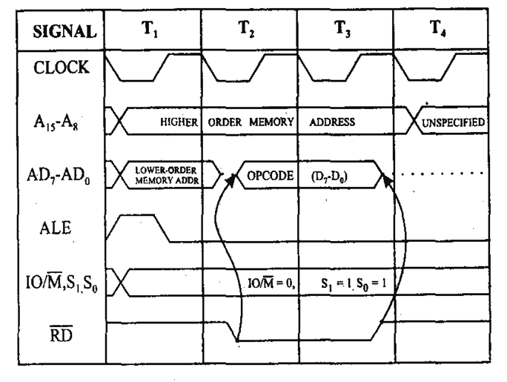
Opcode fetch cycle timing diagram

Slide 6
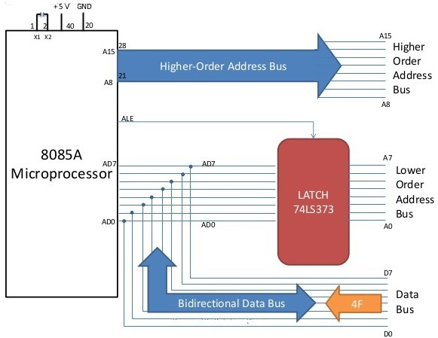

Slide 7
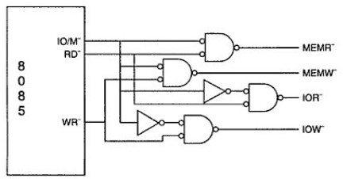
Generation of Control signal

Slide 8
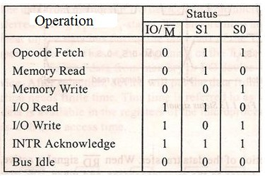
Truth Table of Status Signal

Slide 9
INSTRUCTION SET OF 8085

Slide 10
Instruction Set of 8085
An instruction is a binary pattern designed inside a microprocessor to perform a specific function.
The entire group of instructions that a microprocessor supports is called Instruction Set.
8085 has 246 instructions .
Each instruction is represented by an 8-bit binary value.
These 8-bits of binary value is called Op-Code or
Instruction Byte.

Slide 11
Classification of Instruction Set
Data Transfer Instruction
Arithmetic Instructions
Logical Instructions
Branching Instructions
^{Machine} Control Instructions

Slide 12
1.Data Transfer Instructions
These instructions move data between registers, or between memory and registers.
These instructions copy data from source to destination(without changing the original data ).

Slide 13
DATA TRANSFER (COPY) OPERATIONS
Load a 8-bit number in a Register
Copy from Register to Register
Copy between Register and Memory
Copy between Input/Output Port and Accumulator
Load a 16-bit number in a Register pair
Copy between Register pair and Stack memory

Slide 14
MOV-Copy from source to destination
Opcode Operand
MOV
Rd, Rs M, Rs Rd, M
This instruction copies the contents of the source register into the destination register. (contents of the source register are not altered)
If one of the operands is a memory location, its location is specified by the contents of the HL registers.
Example: MOV B, C or MOV B, M

Slide 15


BEFORE EXECUTION
AFTER EXECUTION
A | 20 | B
MOV B,A
20
A 20 B
A |  | F
B | 30 | C
D |  | E
H | 20 | L | 50
A |  | F
B | 30 | C
D |  | E
H | 20 | L | 50
MOV M,B
30
A F
B |  | C
D |  | E
H | 20 | L | 50
A F
B |  | C | 40
D |  | E
H | 20 | L | 50
MOV C,M
40
40

Slide 16
MVI-Move immediate 8-bit
Opcode Operand
MVI
Rd, Data M, Data
The 8-bit data is stored in the destination register or memory.
If the operand is a memory location, its location is specified by the contents of the H-L registers.
Example: MVI B, 60H or MVI M, 40H

Slide 17
BEFORE EXECUTION
AFTER EXECUTION
A F
B |  | C
D E
H L
A F
B | 60 | C
D E
H L
MVI B,60H
BEFORE EXECUTION
AFTER EXECUTION
204FH
204F
HL=2050
HL=2050
40
MVI M,40H
2051H
2051H

Slide 18
Write an assembly language program to add two 8 bit numbers
ADDRESS | OPCODE | MNEMONIC | OPERAND | COMMENTS
C000 | 3E Data1 | MVI | A, Data1 | Get first byte in the accumulator
C002 | 06 Data2 | MVI | B, Data2 | Get Second byte in register B
C004 | 88 | ADD | B | Addition of Data1 (A) + Data2 (B). Result is saved in accumulator A.
C005 | 76 | HLT (RST 1) |  | Halt/end the program

Slide 19
LDA-Load accumulator
Opcode
Operand
LDA
16-bit address
The contents of a memory location, specified by a 16- bit address in the operand, are copied to the accumulator.
The contents of the source are not altered.
Example: LDA 2000H

Slide 20
BEFORE EXECUTION
AFTER EXECUTION
A
A
30
LDA 2000H
30
30
2000H
2000H

Slide 21
LDAX-Load accumulator indirect
Opcode Operand
LDAX
B/D Register Pair
The contents of the designated register pair point to a memory location.
This instruction copies the contents of that memory location into the accumulator.
The contents of either the register pair or the memory location are not altered.
Example: LDAX D

Slide 22
AFTER EXECUTION
BEFORE EXECUTION
A
F
A
80
F
B
C
80
B
C
80
2030H
2030H
LDAX D
D 20 E 30
D 20 E 30

Slide 23
LXI-Load register pair immediate
Opcode Operand
LXI
Reg. pair, 16-bit data
This instruction loads 16-bit data in the register pair.
Example: LXI H, 2030 H

Slide 24
BEFORE EXECUTION
AFTER EXECUTION
A
F
A | 80 | F
B |  | C
H | 20 | L | 30
B
C
50
50
2030H
2030H
LXI H, 2030
H L
90
2031H
M=50

Slide 25
LHLD-Load H and L registers direct
Opcode Operand
LHLD
16-bit address
This instruction copies the contents of memory location pointed out by 16-bit address into register L.
It copies the contents of next memory location into register H.
Example: LHLD 2030 H

Slide 26
BEFORE EXECUTION
AFTER EXECUTION
A
F
A | 80 | F
B |  | C
H | 85 | L | 00
B
C
00
60
2030H
8500H
LHLD 2030
H L
85
M=60

Slide 27
(COPY) OPERATIONS INSTRUCTIONS
/
Load a 8-bit number 4F in register B
Copy from Register B to Register A
Load a 16-bit number 2050 in Register pair HL
Copy from Register B to Memory Address 2050
Copy between Input/Output Port and Accumulator
MVI B, 4FH
MOV A,B
LXI H, 2050H
MOV M,B
OUT 01H
IN 07H

